Slide 1
PRESENTATION TITLE
LOAN DEFAULT PREDICTION
BY: Monica Patil
DATE : 08/03/2023

Slide 2
TEXT LAYOUT 1
Agenda
Data Science Lifecycle​
Project Overview​
Data
Analysis
Modeling
Model Evaluation
Recommendations

Slide 3
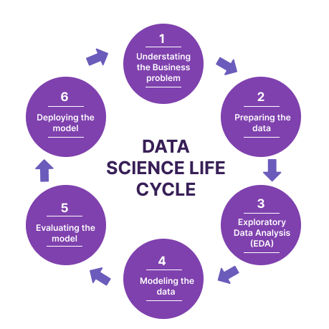
TEXT LAYOUT 1
Data Science Lifecycle
Define the problem: The first step is to understand the business problem that needs to be solved.
Data Collection: After defining the problem, the next step is to collect the relevant data.
Data Preparation: Once the data is collected, it needs to be cleaned, transformed, and preprocessed.
Data Exploration: This step involves visualizing the data and conducting exploratory data analysis (EDA) to understand the patterns and relationships in the data.
Modeling: Once the data is prepared and explored, the next step is to build a predictive model using machine learning algorithms.
Evaluation: After building the model, it needs to be evaluated using appropriate metrics to assess its performance. This could include accuracy, precision, recall, and F1 score.
Deployment: Once the model is evaluated and validated, it can be deployed in a production environment.
Monitoring and Maintenance: Once the model is deployed, it needs to be monitored and maintained to ensure its performance and reliability.

Slide 4
TEXT LAYOUT 1
Project Overview
Business Problem: This problem statement outlines the business's concern about loan defaults and the impact it has on their financial stability.
Business Objective: This business objective statement highlights the goal of the project, which is to develop an accurate predictive model that can identify high-risk borrowers early in the loan process. The statement also outlines the intended benefits of the project, including reducing default rates and associated losses, improving financial performance and stability, and optimizing the loan approval process. By achieving these objectives, the business can effectively manage risk and ensure long-term success.
Hypothesis: Hypothesis statement outlines the specific variables that the project team believes will have a significant impact on loan defaults. By stating this hypothesis, the project team can focus on these variables during data exploration and feature engineering to ensure that the predictive model is optimized for the most important factors affecting loan defaults

Slide 5
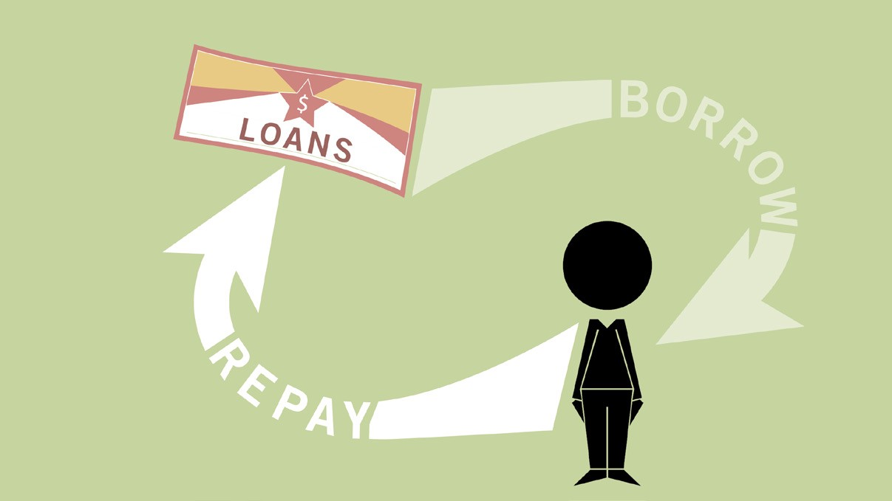
TEXT LAYOUT 1
Process Overview / Solution
Define the problem and set the project objectives: Identify the business problem and objectives, as well as the data available for analysis.
Data exploration and cleaning: Review the data to ensure that it's clean and ready for analysis. This may involve checking for missing data, outliers, and other issues that may affect the model's accuracy.
Feature engineering: Identify the most relevant variables that are likely to impact loan defaults. This may involve creating new variables from existing data or selecting the most important variables based on statistical analysis.
Model selection and building: Choose the most appropriate model for the project, such as logistic regression, decision trees, or random forests. Train and evaluate the model using historical data, adjusting the parameters as needed to improve its accuracy.
Model evaluation and refinement: Assess the performance of the model using appropriate metrics, such as precision, recall, and F1 score. Refine the model by adjusting the feature selection, parameter tuning, or using an ensemble of models to improve its accuracy.
Model deployment and monitoring: Deploy the model in a production environment, ensuring that it integrates with existing systems and is scalable. Monitor the model's performance over time, updating it as new data becomes available or changing market conditions require.
Business impact analysis: Evaluate the model's impact on the business objectives, such as reducing default rates, improving profitability, or optimizing loan approvals. Use this analysis to identify areas for improvement and refine the model as needed.
By following this process, the project team can effectively review and solve the loan default prediction problem, delivering a predictive model that drives business value and improves overall financial stability.

Slide 6
TEXT LAYOUT 1
Data
For the Project the data was collected from Kaggle :https://www.kaggle.com/datasets/altruistdelhite04/loan-prediction-problem-dataset
The data consist two csv files Train and Test , Training dataset has 614 observations and 13 columns and Testing dataset has 367 observations and 12 columns.
The data has 981 observations and 13 variables, with 8 Columns
Loan_ID, Gender, Married,Dependents,Education,Self_Employed,Property_Area,Loan_Status with datatype category i.e.cateogorical and remaining
The remaining 5 columns(ApplicantIncome,CoapplicantIncome,LoanAmount,Loan_Amount_Term,Credit_History) with datatype numerical. The training dataset or csv file has 614 observations and 13 columns and testing dataset or csv file has 367 observations and 12 columns

Slide 7
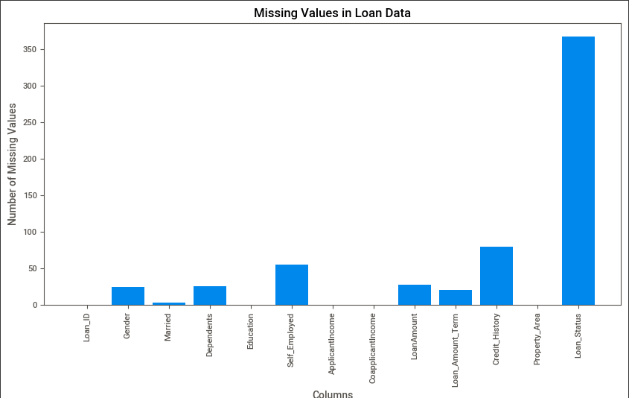
TEXT LAYOUT 1
Analysis
Analysis on missing values:
The Right hand side plot shows the graphical representation showing the missing values present in the dataset whole by combing Train and Test dataset.
Training and Testing dataset has many null values, and will be treated before building or doing the machine learning task or process.

Slide 8
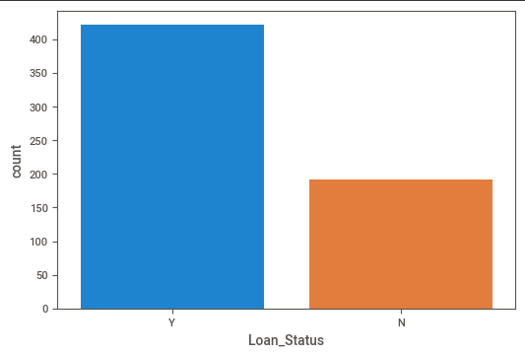
TEXT LAYOUT 1
Analysis
Analysis on Loan defaulting:
The Right hand side plot shows the graphical representation shows the people how many people has the loans acceptance.
With the given plot we can say that 'yes' credit status in the data is higher.
If this ratio is too high, it can be a problem for machine learning algorithms.

Slide 9
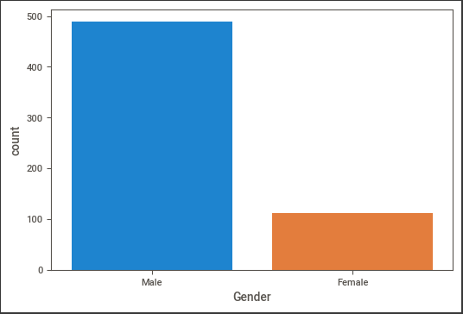
TEXT LAYOUT 1
Analysis
Analysis on Gender compare when it comes to defaulting on loans:
The Right hand side plot shows the graphical representation shows the comparison of gender defaulting the loans.
Value counts of Gender we can see the male are common among the observations.

Slide 10
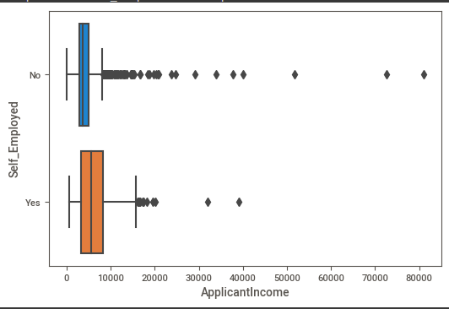
TEXT LAYOUT 1
Analysis
Analysis on incomes of those who are employed compare to those who are self employed :
The Right hand side plot shows the graphical representation shows the comparison of incomes of those who are employed compare to those who are self employed.
It is seen that the incomes of those who are employed are higher on average. However, statistical tests will be done to make a clear inference.

Slide 11
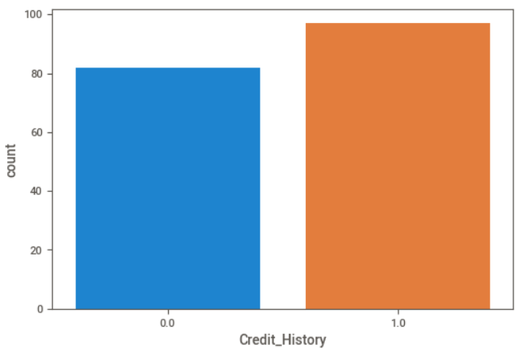
TEXT LAYOUT 1
Analysis
Analysis on applicants with a credit history more likely to default than those who do not have one :
The Right hand side plot shows the graphical representation shows the comparison of applicants with a credit history more likely to default than those who do not have .
A statistical test will be made between those who have a credit history and are in default, and those who do not have a credit history and are in default
It has been observed that the number of defaults is higher for those with a credit history. Now, a statistical test will be conducted to investigate whether the likelihood of default is higher for those with a credit history compared to those without one.
According to the result of the statistical test (p < 0.05), the likelihood of default is higher for those who have a credit history compared to those who do not have one.

Slide 12
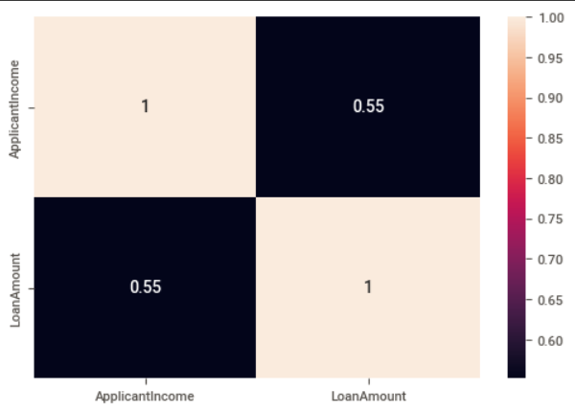
TEXT LAYOUT 1
Analysis
Analysis on correlation between the applicant's income and the loan amount they applied for :
The Right hand side plot shows the graphical representation shows the comparison of correlation between the applicant's income and the loan amount they applied for.
There is 0.55 correlation shows that there is not a strong relationship between the income of the person applying for credit and the amount of credit applied for..

Slide 13
TEXT LAYOUT 1
Modeling
Before we start modelling the machine learning model we have to remove the null values, as in analysis slide we see we have very high NAN values or Missing values.
We will Treat it with replacing the values with Median and mode.
We will do Feature selection and split the data in X , Y to train the model .
To remove the scaling problem we will use the StandardScaler to scale the data in preferable range.
We will use the K-fold Cross validations technique to get the scores for the 5 folds run we get Best Cv score has 81%.
As it is the Classification Problem we will use the Logistic regression as our algorithm for our dataset and problem.

Slide 14
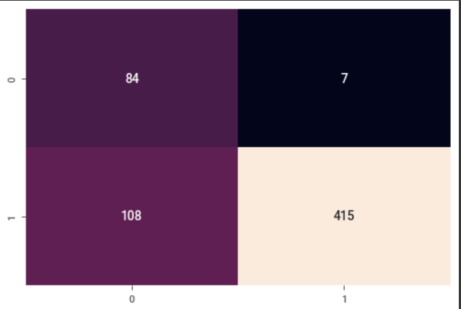
TEXT LAYOUT 1
Model Evaluation
After running cross validation and getting best model for our modelling.
We will fit our variables with best fit and best model which Logistic Regression.
After Fitting the model we get the Accuracy of 81%.
Right side is the confusion matrix for the model we run. It showing the classes probability.
With the help of the confusion matrix we got values for our classes we can calculate Precision, Recall .
Precision and Recall where Precision is 0.92 and Recall 0.43

Slide 15
TEXT LAYOUT 1
Recommendations
For Recommendation like to add future points to avoid or solve the problem statement:
Feature Engineering: Continue exploring and refining the features used in the model. Consider incorporating new features that may be relevant to predicting loan defaults, such as the borrower's credit score or payment history.
Data Quality: Ensure that the data used for training and testing the model is accurate, complete, and up-to-date. Develop a process for regularly checking the quality of the data and addressing any issues that arise.
Business Impact: Continuously evaluate the business impact of the model and adjust as necessary to meet business objectives. Develop a process for regularly reporting on the model's performance and impact to stakeholder
Compliance: Ensure that the model is compliant with all applicable regulations and guidelines, including fair lending laws and data privacy regulations. Develop a process for regularly reviewing and updating the model to ensure ongoing compliance.
Collaboration: Consider collaborating with other departments or external partners to gain access to additional data sources or expertise. This can help improve the accuracy and effectiveness of the model, as well as foster a culture of collaboration within the organization.

Slide 16


